Slide 1

BLOCKCHAIN:
DRUG COUNTERFEITING
PRESENTED BY TEAM - ERROR 405 FOUND

Slide 2


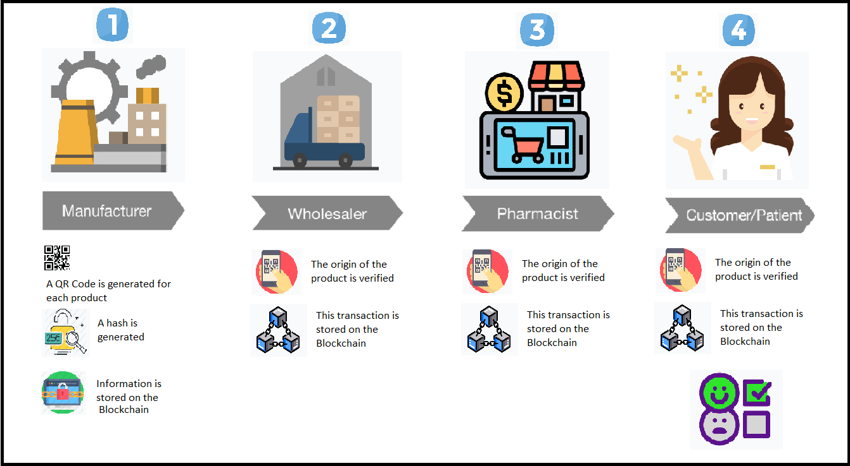
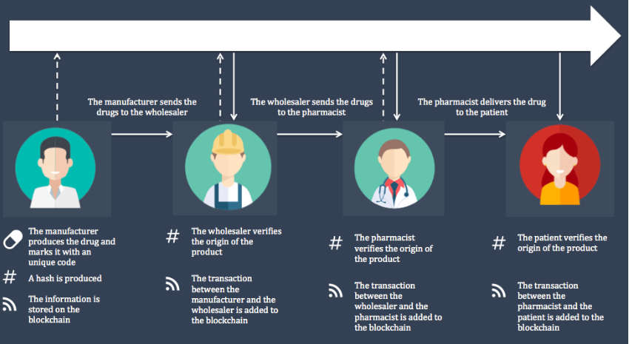

Slide 3
TECHNOLOGY STACK
PYTHON
GANACHE
FLASK
ETHEREUM
WALLET
ETHEREUM
POSTMAN

Slide 4
MERITS
DEMERITS
- Stability
- Decentralize
- Data is Immutable
- Scalablity
- Inefficient due to proof of work
- Storage

